Slide 1

Shopping Trends & Customer Behavior Analysis Using SQL
Visual Insights from SQL Queries to Drive Marketing, Sales, and Operational Strategy
Created By : Akeira green

Slide 2
🧰 Tools & Dataset Overview
Content:
Dataset: Retail shopping behavior data including customer demographics, purchase history, product categories, review ratings, payment/shipping preferences, and discount usage.
SQL Platform: MySQL – used to query, filter, group, and summarize behavioral and sales data.
Visualization Tool: Microsoft Excel – created dynamic charts and visuals from SQL outputs.
Presentation Tool: Microsoft PowerPoint – to communicate insights clearly through structured, visual storytelling.

Slide 3
🛒 Shopping Trends SQL Analysis Project Overview This presentation showcases visual insights from an in-depth SQL analysis of customer shopping behavior, sales performance, and operational patterns. 🔍 What You'll Find Inside: Customer Behavior: Top 10 high-value customers, frequency trends, review impact Sales Insights: Seasonal revenue, purchase volume, discount/promo effectiveness Operational Patterns: Preferred shipping methods & payment options Marketing Insights: Correlation between satisfaction and spending habits 📈 Each chart is directly tied to SQL queries used in the project, with clear insights and strategic recommendations for stakeholders in sales, marketing, and logistics.

Slide 4
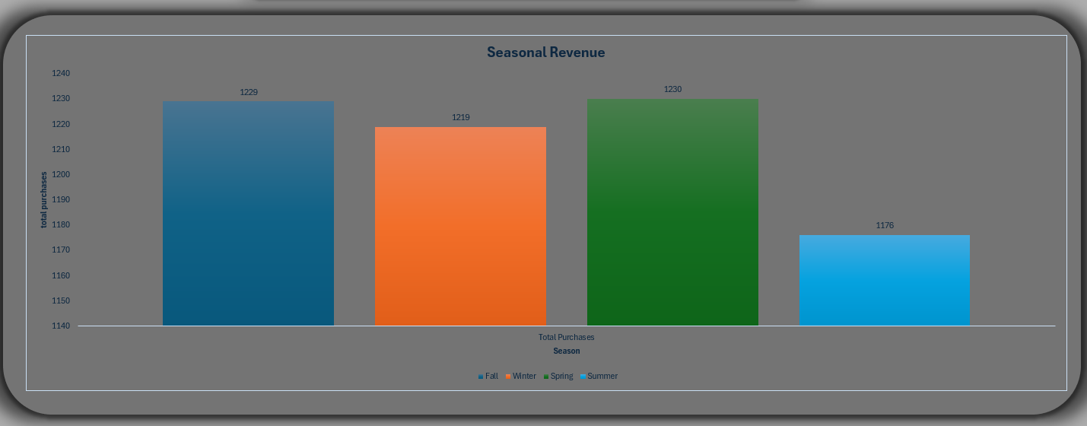
Which seasons generate the most purchases? Fall generated the highest revenue, while Spring had the most purchases. Marketing efforts should be aligned with Fall’s high-value window, while volume-based promotions are better suited for Spring.

Slide 5
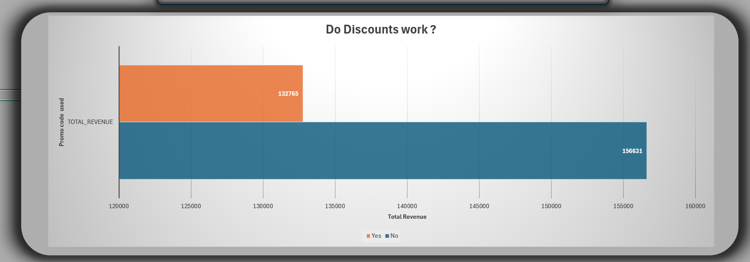
Do discounts and promo codes increase purchases? Promo codes drove fewer total purchases and revenue than discounts alone. This suggests that blanket promo codes may attract low-value, one-time customers — making discount optimization a better strategy.

Slide 6
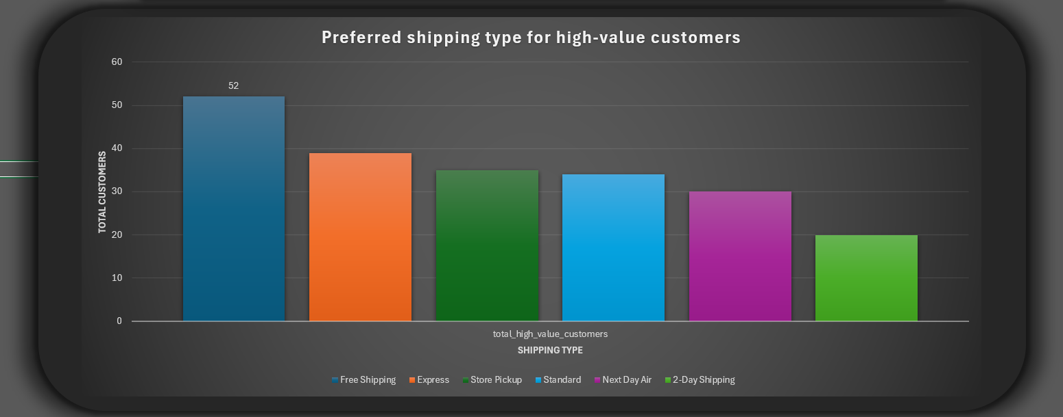
Which shipping type is preferred by high-value customers? Free shipping is overwhelmingly favored by weekly subscribers, while express shipping is second. Loyalty programs should prioritize free shipping to retain top-tier customers.

Slide 7
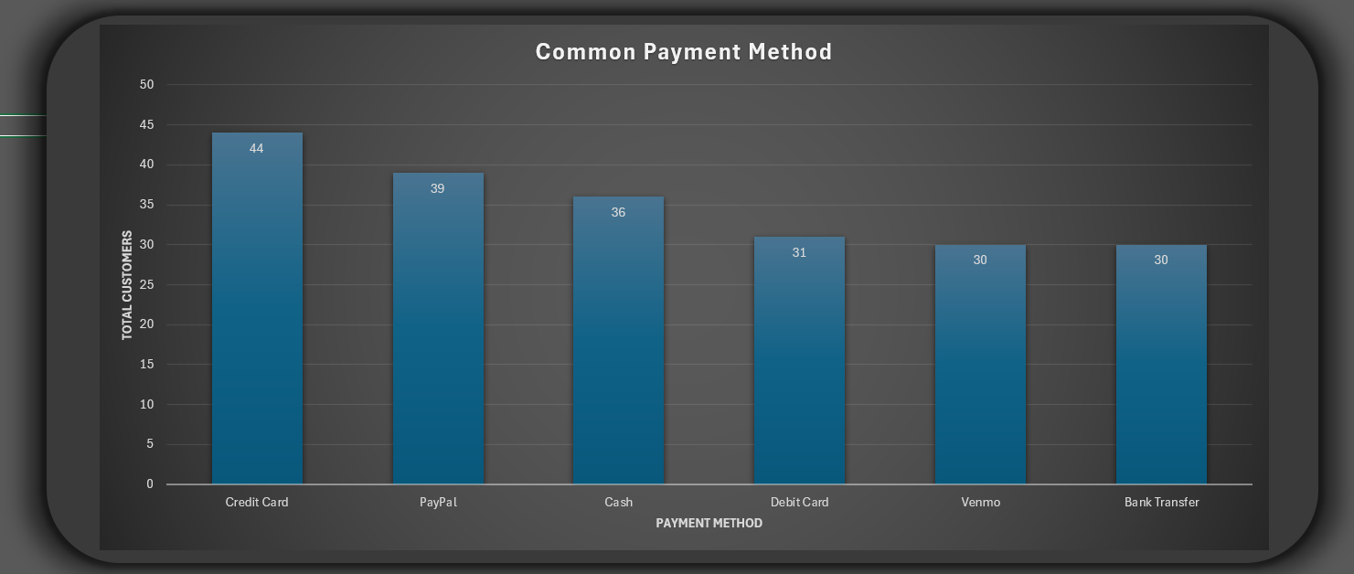
What payment methods are most common among the frequent shoppers? Credit Cards remain the dominant method among frequent shoppers, followed closely by PayPal. Ensuring flexible and secure digital options supports a smooth checkout experience and high conversion rates.

Slide 8
🔚 Conclusion & Next Steps
Content:
Conclusion: The SQL analysis revealed actionable insights into customer behavior, revenue cycles,
discount effectiveness, and operational preferences.
Patterns in high-value customer behavior (weekly shoppers with subscriptions) consistently aligned
with loyalty-driving features like free shipping and reliable payment options.
Next Steps:
Expand analysis to include regional trends or category-level performance
Integrate SQL outputs with a real-time dashboard tool (e.g., Power BI or Tableau)
Explore predictive modeling to forecast purchase behavior and churn
Use findings to inform targeted marketing campaigns and optimize promotional spend

